Slide 1
Components of Evolutionary Algorithms (EAs). The evolution from direct search to stochastic search.

Slide 2
I. EA Components (Evolutionary Algorithms)
Representation (definition of population members)
Evaluation function (fitness)
Population
Parent selection mechanism
Variation operators (recombination and mutation)
Next-generation member selection mechanism
Definition of the initialization module (determination of the initial population)
Definition of the termination condition

Slide 3
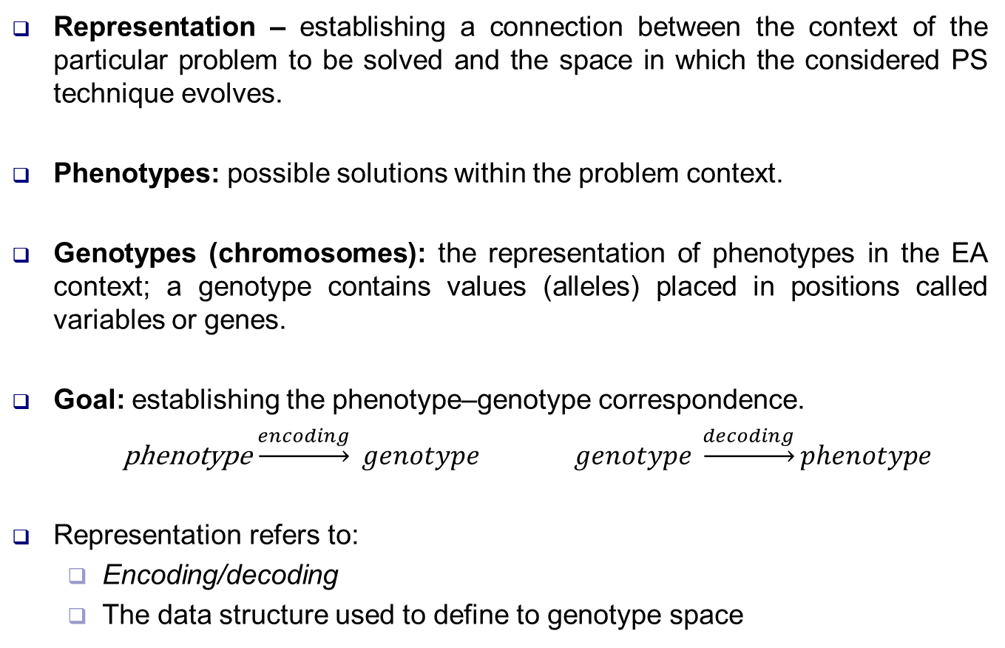
II. EA Components. Representation
Representation – establishing a connection between the context of the particular problem to be solved and the space in which the considered PS technique evolves.
Phenotypes: possible solutions within the problem context.
Genotypes (chromosomes): the representation of phenotypes in the EA context; a genotype contains values (alleles) placed in positions called variables or genes.
Goal: establishing the phenotype–genotype correspondence.
phenotype$\underset{→}{encoding} genotype$ $genotype \underset{→}{decoding}phenotype$
Representation refers to:
Encoding/decoding
The data structure used to define to genotype space

Slide 4

Example of representation using permutations
$$P=\left(2, 7, 5, 8, 1, 4, 6, 3\right)$$

Slide 5
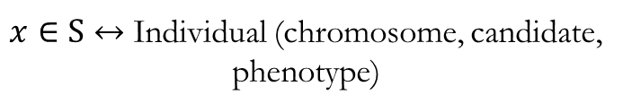


Example of representation. The case where phenotype = genotype
$$f:[3, 10]→ℝ$$
$$f\left(x\right)=x^{3}∙sin\left(\frac{x}{3}\right)+x^{3}∙cos\left(2∗x\right)−x∙sin(3∙x) + x∙cos(x)$$
Solution space: $S=\left[3, 10\right]$
$x∈S↔$ Individual (chromosome, candidate, phenotype)

Slide 6
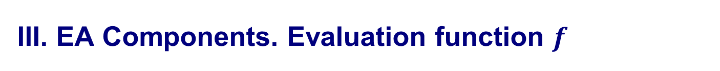
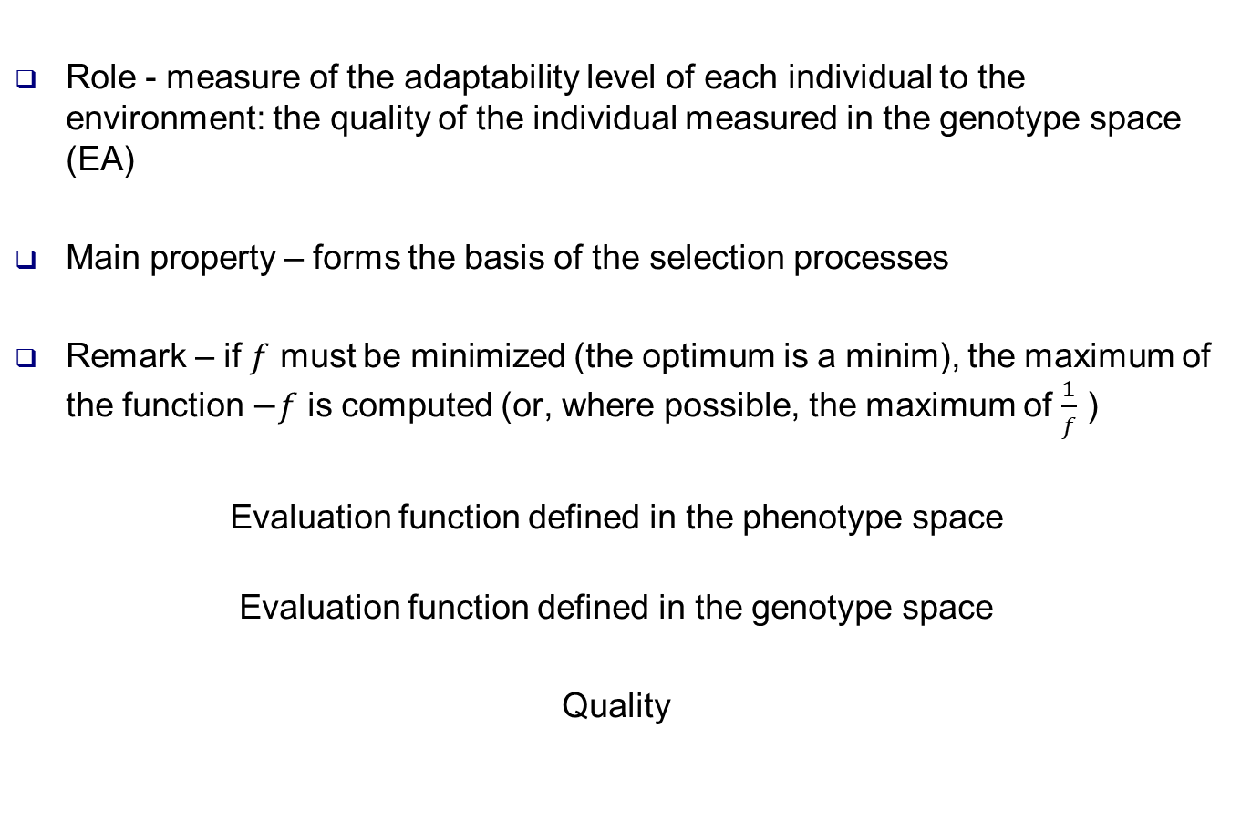
III. EA Components. Evaluation function $f$
Role - measure of the adaptability level of each individual to the environment: the quality of the individual measured in the genotype space (EA)
Main property – forms the basis of the selection processes
Remark – if $f$ must be minimized (the optimum is a minim), the maximum of the function $−f$ is computed (or, where possible, the maximum of $\frac{1}{f}$ )
Evaluation function defined in the phenotype space
Evaluation function defined in the genotype space
Quality

Slide 7
IV. EA Components. Population
Population – multiset de genotypes – unit of evolution
Individual = static, does not evolve, does not adapt
Population = dynamic, evolves, adapts
Role – maintains a collection of genotypes corresponding to candidate solutions
Genetic selection operators are defined at the population level
Types of populations – fixed size throughout the EA (the simplest and most commonly used models) and variable size
Main characteristic: diversity, defined by:
Number of distinct phenotypes/genotypes
Number of distinct values of the evaluation function (fitness)
Entropy-based measures, etc.

Slide 8

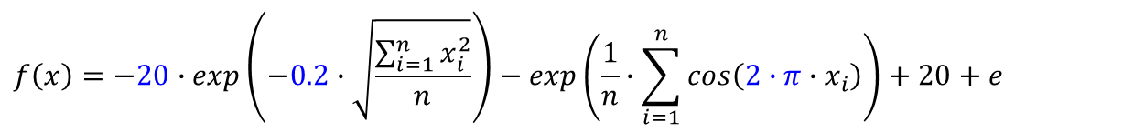


IV. EA Components. Population
$$f:ℝ^{n}→ℝ, x∈ℝ^{n}$$
$$f\left(x\right)=−20∙exp\left(−0.2∙\sqrt{\frac{\sum_{i=1}^{n}{x_{i}^{2}}}{n}}\right)−exp\left(\frac{1}{n}∙\sum_{i=1}^{n}{cos\left(2∙π∙x_{i}\right)}\right)+20+e$$
Random individual
$$n=2, f:\text{[−2, 2] }×\text{ [−2, 2]}→ℝ$$
⇨ Solution space: $S$ $=\text{[−2, 2] }×\text{ [−2, 2]}$

Slide 9



IV. EA Components. Population
$$f:[−2, 2]→ℝ$$
$$f\left(x\right)=x^{3}−sin\left(\frac{x}{3}\right)+3∙sin\left(7∗x+0.2\right)+2∙cos(\frac{x}{5}−0.4) +1$$
Solution space: $S=\left[−2, 2\right]$
Group of individuals $x∈S↔$ Population

Slide 10



IV. EA Components. Population
$$f:ℝ^{2}→ℝ, x∈ℝ^{2}, x=(x_{1},x_{2})$$
Random population
$$f\left(x\right)=10−x_{1}^{2}−x_{2}^{2}$$
Solution space: $S$ $=\text{[−2, 2] }×\text{ [−2, 2]}$

Slide 11

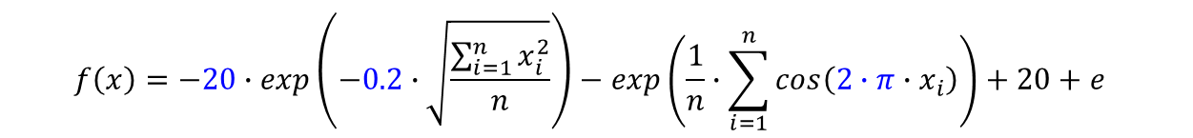


IV. EA Components. Population
$$f:ℝ^{n}→ℝ, x∈ℝ^{n}$$
$$f\left(x\right)=−20∙exp\left(−0.2∙\sqrt{\frac{\sum_{i=1}^{n}{x_{i}^{2}}}{n}}\right)−exp\left(\frac{1}{n}∙\sum_{i=1}^{n}{cos\left(2∙π∙x_{i}\right)}\right)+20+e$$
$$n=2, f:\text{[}\text{−}\text{2}\text{, }\text{2}\text{] }×\text{ [}\text{−}\text{2}\text{, }\text{2}\text{]}→ℝ$$
⇨ Solution space: $S$ $=\text{[}\text{−}\text{2}\text{, }\text{2}\text{] }×\text{ [}\text{−}\text{2}\text{, }\text{2}\text{]}$
Population evolution: ES, minimizing the Ackley function

Slide 12
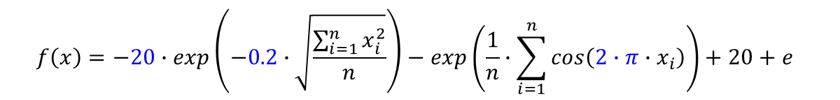

IV. EA Components. Population
$$f:ℝ^{n}→ℝ, x∈ℝ^{n}$$
$$f\left(x\right)=−20∙exp\left(−0.2∙\sqrt{\frac{\sum_{i=1}^{n}{x_{i}^{2}}}{n}}\right)−exp\left(\frac{1}{n}∙\sum_{i=1}^{n}{cos\left(2∙π∙x_{i}\right)}\right)+20+e$$
$n=3, f:\text{[−2, 2] }×\text{ [−2, 2]}×\text{ [−2, 2]}→ℝ$ ⇨ Solution space: $S$ $=\text{[−2, 2] }×\text{ [−2, 2]}×\text{ [−2, 2]}$
Population evolution:
ES, minimizing the Ackley function

Slide 13
IV. EA Components. Population
Population
Initial
Current population (Generation)
Parent population (Mating pool) → selected from the current generation
Offspring population → generated from the parent pool
Next population (Generation) → selected from the current generation and the new individuals
Initial population
It is constructed by randomly selecting (uniform distribution) individuals from the phenotype space and converting them into the genotype space.

Slide 14
V. EA Components. Parent selection
Role: to distinguish between individuals in the population based on their quality
It gives priority to the best individuals to reproduce, thus allowing them to contribute to the generation of the next population.
Probabilistic parent selection mechanism: the probability that an individual is chosen for reproduction is directly proportional to its quality.
It enforces the improvement of the overall population quality from one generation to the next.
“Weak” individuals are not eliminated from the reproduction selection process; they are simply assigned small but non-zero selection probabilities.
The search algorithm is not greedy.
The risk of identifying a local optimum is reduced.

Slide 15
VI. EA Components. Variation Operators
The global optimum of the objective function can be obtained if the variation operators used ensure the generation of any genotype representing a potential solution to the optimization problem.
Mutation operator: a unary operator.
When applied to a genotype, it produces a “mutant” variant, called offspring or child. The mutation operator is always stochastic: the result depends on a series of random choices.
The role of mutation depends on the type of implemented algorithm: in the case of Genetic Algorithms (GA), mutation serves to “refresh” the genetic structure of a population.
In general, a mutation operator allows the modification of any allele in a chromosome to any possible variant, with a non-zero probability.

Slide 16
VI. EA Components. Variation Operators
Recombination operator: a binary operator that produces one or two child genotypes by combining information from two parent genotypes.
Recombination is stochastic: the selection of the parent parts to be combined and the type of recombination are based on random draws.
In Genetic Algorithms (GA), it is the most frequently used variation operator.
In EA-based approaches, recombination operators with arity greater than 2 may also be used.
Applying EA leads to the creation of direct offspring through random crossovers. The offspring may have undesirable traits, may be qualitatively similar to or even inferior to their parents, and only a small proportion typically exhibit characteristics superior to those of the parents.

Slide 17
VII. EA Components. Transition to a new generation
Role: differentiates individuals according to their quality — similar to the parent selection process, but applied at a different stage in the evolution of an EA.
The mechanism involves applying a decision function to each individual belonging either to the current population or to the set of offspring (mutated or not).
The decision function is usually constructed based on the evaluation (fitness) function, taking into account the quality of each individual and, in some cases, the age factor.
Examples:
The decision function is based exclusively on the evaluation function
The decision function is based exclusively on the age factor
The decision is made based on both age and quality

Slide 18
VIII. EA Components – Initialization. Termination Condition
Initialization: the creation of the initial population is generally performed by randomly generating phenotypes and then obtaining the associated multiset of genotypes.
Termination Condition:
Reaching a maximum number of iterations (generations);
Reaching a maximum number of individual fitness evaluations;
For a specified period (a given number of iterations or evaluations), the quality of the current population does not significantly improve (it remains below a given threshold);
The population diversity falls below a given threshold.

Slide 19
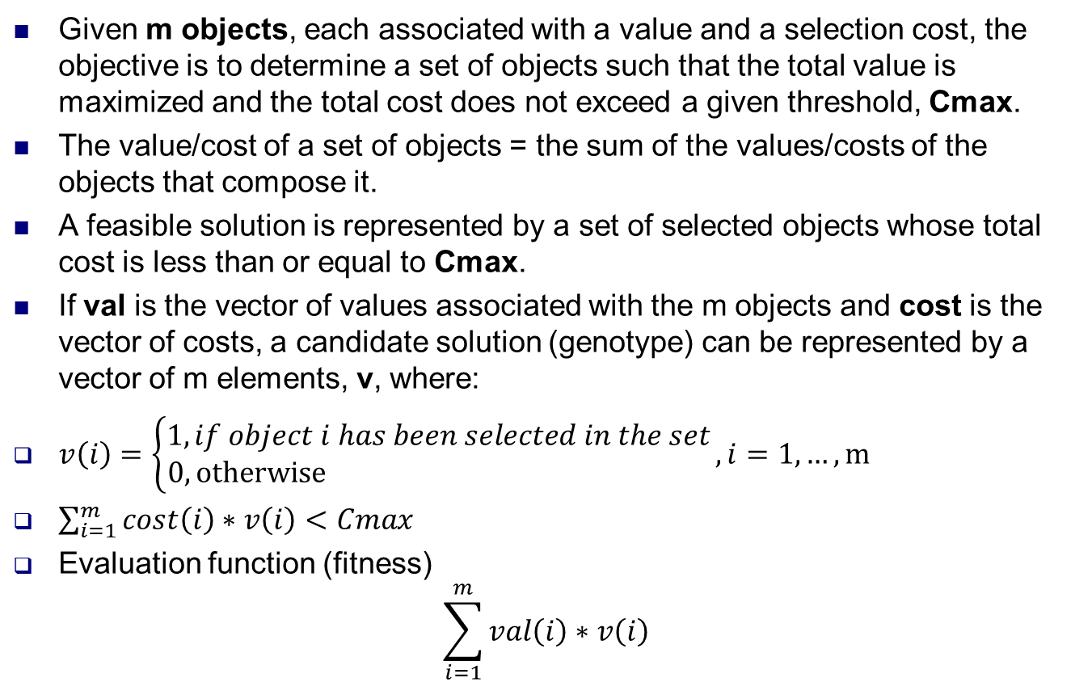
Example – The 0-1 Knapsack Problem
Given m objects, each associated with a value and a selection cost, the objective is to determine a set of objects such that the total value is maximized and the total cost does not exceed a given threshold, Cmax.
The value/cost of a set of objects = the sum of the values/costs of the objects that compose it.
A feasible solution is represented by a set of selected objects whose total cost is less than or equal to Cmax.
If val is the vector of values associated with the m objects and cost is the vector of costs, a candidate solution (genotype) can be represented by a vector of m elements, v, where:
$v\left(i\right)=\left\{\begin{aligned}1, if object i has been selected in the set \\ 0, otherwise \end{aligned}\right., i=1,…,m$
$\sum_{i=1}^{m}{cost\left(i\right)∗v\left(i\right)}<Cmax$
Evaluation function (fitness)
$$\sum_{i=1}^{m}{val\left(i\right)∗v\left(i\right)}$$

Slide 20
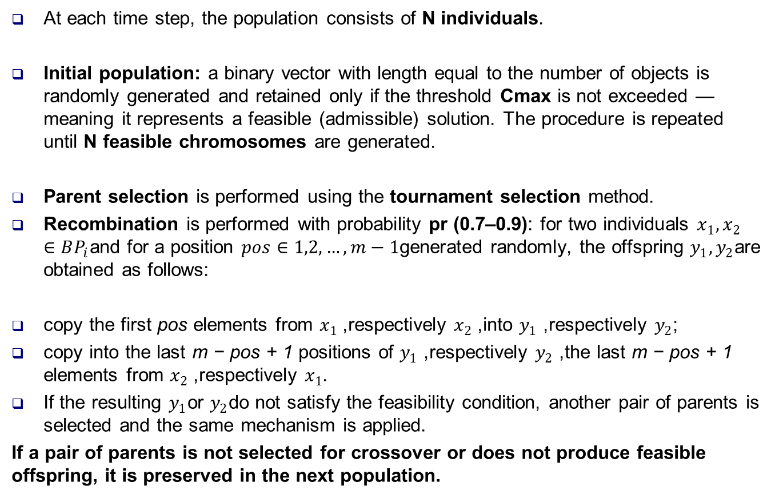
Exemple – The 0-1 Knapsack Problem
At each time step, the population consists of N individuals.
Initial population: a binary vector with length equal to the number of objects is randomly generated and retained only if the threshold Cmax is not exceeded — meaning it represents a feasible (admissible) solution. The procedure is repeated until N feasible chromosomes are generated.
Parent selection is performed using the tournament selection method.
Recombination is performed with probability pr (0.7–0.9): for two individuals $x_{1},x_{2}∈BP_{i}$and for a position $pos∈1,2,…,m−1$generated randomly, the offspring $y_{1},y_{2}$are obtained as follows:
copy the first pos elements from $x_{1}$, respectively $x_{2}$, into $y_{1}$, respectively $y_{2}$;
copy into the last m − pos + 1 positions of $y_{1}$, respectively $y_{2}$, the last m − pos + 1 elements from $x_{2}$, respectively $x_{1}$.
If the resulting $y_{1}$or $y_{2}$do not satisfy the feasibility condition, another pair of parents is selected and the same mechanism is applied.
If a pair of parents is not selected for crossover or does not produce feasible offspring, it is preserved in the next population.

Slide 21
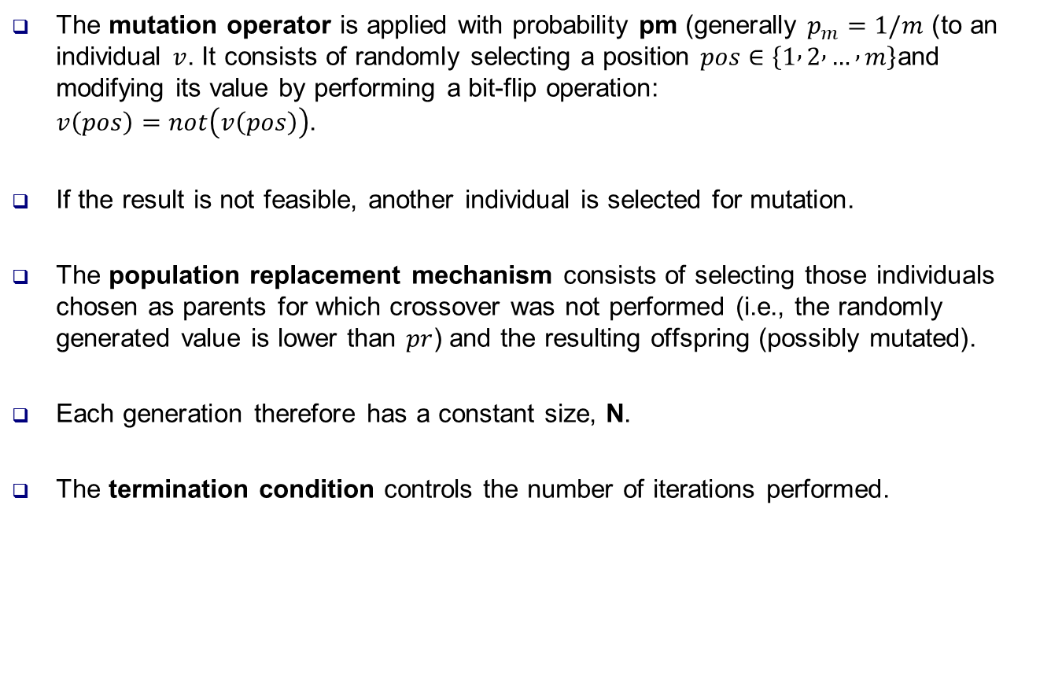
Example – The 0-1 Knapsack Problem
The mutation operator is applied with probability pm (generally $p_{m}=1/m$) to an individual $v$. It consists of randomly selecting a position $pos∈\left\{1 , 2 , … , m\right\}$and modifying its value by performing a bit-flip operation: $v\left(pos\right)=not\left(v\left(pos\right)\right)$.
If the result is not feasible, another individual is selected for mutation.
The population replacement mechanism consists of selecting those individuals chosen as parents for which crossover was not performed (i.e., the randomly generated value is lower than $pr$) and the resulting offspring (possibly mutated).
Each generation therefore has a constant size, N.
The termination condition controls the number of iterations performed.

Slide 22
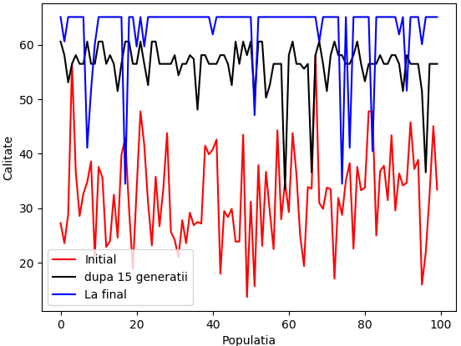
Example – The 0-1 Knapsack Problem
Input:
Value - 4.5 6 8 5.4 10.2 3.2 4.2 8.3 3.2 4.5 9 10.9 5 6.2 7 8.2
Cost - 3 2 2.4 6.8 5 6.2 5 4.8 5 0.2 3 4.8 7 7.1 9.7 4
Cmax= 26.3
The following results can be obtained (in this example = optimal):
Maximum calculated profit: 65.10000000000001
For the selection of objects: [0 1 1 0 1 0 0 1 0 1 1 1 0 0 0 1]

Slide 23
X. Evolution: Direct Search – Stochastic Search
Evolution: Direct search – stochastic search includes methods such as “hill climbing” and “simulated annealing.”
Hill Climbing Methods
An improved iterative technique applied to a single point in the search space.
At each iteration, a new point located in the neighborhood of the current processed point is selected.
If this point produces a better value (according to the considered optimization criterion) of the objective function, it becomes the current point.
Otherwise, another neighbor of the current point is selected, and the process continues similarly.
The algorithm stops when none of the neighboring points improves the value of the objective function.
These methods usually converge to a local optimum, depending on the starting point. To increase the performance of such models, they are executed from a large number of starting points.

Slide 24
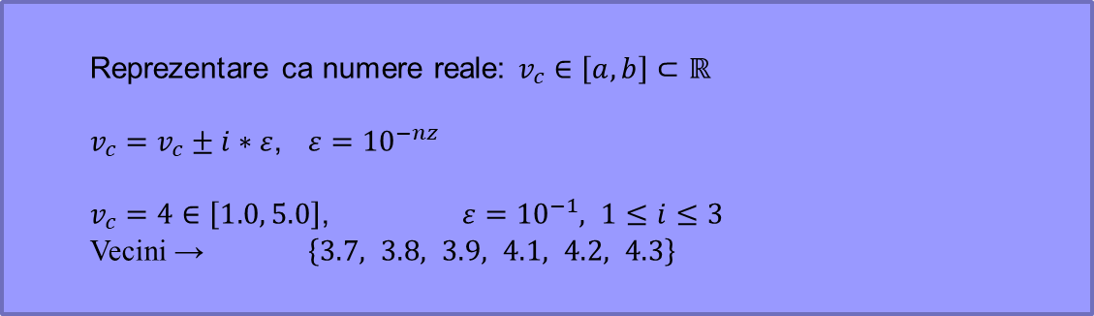
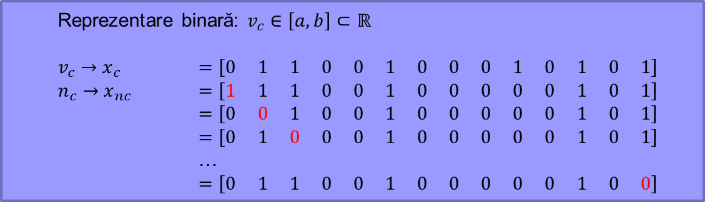
XI. Hill Climbing – Neighbor Selection
Neighbor selection depends on the representation. It can influence the quality of the results.
Examples
Modifying one bit at a time in the representation (e.g., 0–1 Knapsack problem)
Adding/subtracting a “step” (e.g., function optimization)
Transpositions (e.g., N-Queens problem)
Reprezentare binară: $v_{c}∈\left[a,b\right]⊂ℝ$
$v_{c}→{ x}_{c}$ $=\left[0 1 1 0 0 1 0 0 0 1 0 1 0 1\right]$
$n_{c}→{ x}_{nc}$ $=\left[1 1 1 0 0 1 0 0 0 0 0 1 0 1\right]$
$=\left[0 0 1 0 0 1 0 0 0 0 0 1 0 1\right]$
$=\left[0 1 0 0 0 1 0 0 0 0 0 1 0 1\right]$
…
$=\left[0 1 1 0 0 1 0 0 0 0 0 1 0 0\right]$
P = (2, 7, 5, 1, 4, 6, 3) ⇨
(7, 2, 5, 1, 4, 6, 3)
(5, 7, 2, 1, 4, 6, 3)
(1, 7, 5, 2, 4, 6, 3)
…
(2, 7, 5, 1, 4, 3, 6)
Reprezentare ca numere reale: $v_{c}∈\left[a,b\right]⊂ℝ$
$v_{c}=v_{c}±i∗ε$, $ε={10}^{−nz}$
$v_{c}=4∈\left[1.0, 5.0\right]$, $ε={10}^{−1}, 1≤i≤3$
Vecini → $\left\{3.7, 3.8, 3.9, 4.1, 4.2, 4.3\right\}$

Slide 25
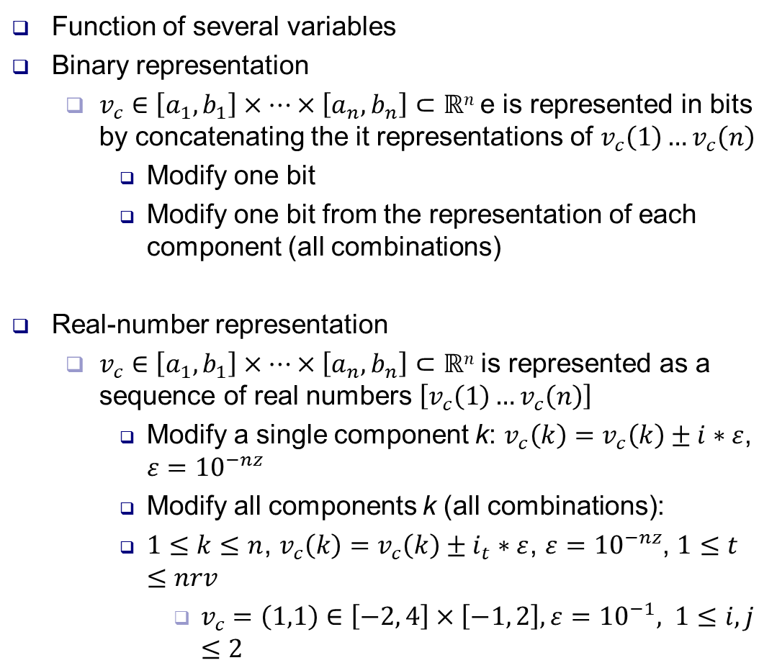
XI. Hill Climbing – Neighbor Selection
Function of several variables
Binary representation
$v_{c}∈\left[a_{1},b_{1}\right]×…×\left[a_{n},b_{n}\right]⊂ℝn$e is represented in bits by concatenating the it representations of $v_{c}\left(1\right)…v_{c}\left(n\right)$
Modify one bit
Modify one bit from the representation of each component (all combinations)
Real-number representation
$v_{c}∈\left[a_{1},b_{1}\right]×…×\left[a_{n},b_{n}\right]⊂ℝn$ is represented as a sequence of real numbers $\left[v_{c}\left(1\right)…v_{c}\left(n\right)\right]$
Modify a single component k: $v_{c}\left(k\right)=v_{c}\left(k\right)±i∗ε$, $ε={10}^{−nz}$
Modify all components k (all combinations):
$1≤k≤n$, $v_{c}\left(k\right)=v_{c}\left(k\right)±i_{t}∗ε$, $ε={10}^{−nz}$, $1≤t≤nrv$
$v_{c}=\left(1,1\right)∈\left[−2, 4\right]×\left[−1, 2\right], ε={10}^{−1}, 1≤i,j≤2$
0.8000 0.8000
0.8000 0.9000
0.8000 1.0000
0.8000 1.1000
0.8000 1.2000
0.9000 0.8000
0.9000 0.9000
0.9000 1.0000
0.9000 1.1000
0.9000 1.2000
1.0000 0.8000
1.0000 0.9000
1.0000 1.1000
1.0000 1.2000
1.1000 0.8000
1.1000 0.9000
1.1000 1.0000
1.1000 1.1000
1.1000 1.2000
1.2000 0.8000
1.2000 0.9000
1.2000 1.0000
1.2000 1.1000
1.2000 1.2000

Slide 26

XI. Hillclimbing algorithm. General scheme
$f$ – function to be maximized
MAX – nr. puncte de start
local – blocat în maxim local? (adevărat / fals)
V – vector cu puncte finale
v – cel mai bun punct obținut
t – contor puncte
t=0
repeat
local=fals
choose randomly a current point v_{c}
evaluate v_{c}
repeat
consider the points in the neighborhood of v_{c}
choose the point v_{n} with the highest function value
if f(v_{c})<f(v_{n})
then v_{c}=v_{n}
else local=true
until local == true
t=t+1
V(t)=v_{c}
until t == MAX
choose v from V such that f(v)>=f(V(i)) for all i=1..MAX

Slide 27


XI. Hillclimbing algorithm. Examples
$$f:[3, 10]→ℝ$$
Solution space: $S=\left[3, 10\right]$
$$f\left(x\right)=x^{3}∙sin\left(\frac{x}{3}\right)+x^{3}∙cos\left(2∗x\right)−x∙sin(3∙x) + x∙cos(x)$$
Hillclimbing, 30 initial points
(neighbors, equal distances)
Hillclimbing, 10 initial points
(neighbors at 1 bit)

Slide 28
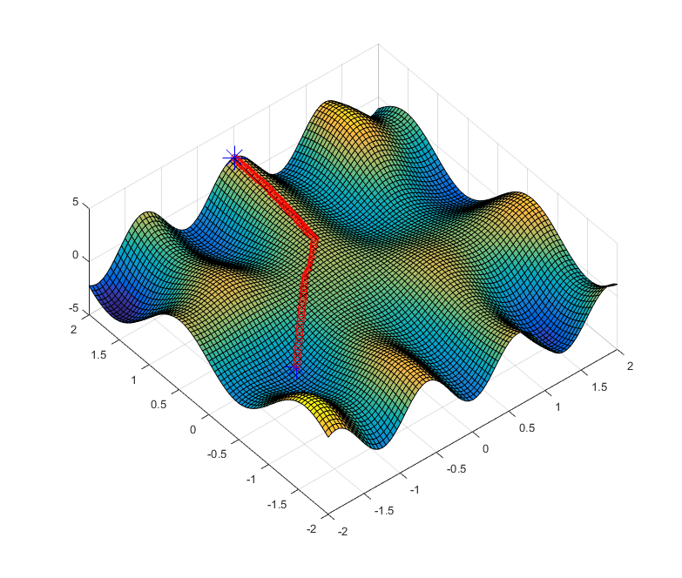

XI. Hillclimbing algorithm. Examples
Example: maximize $f:\left[−2,2\right]×\left[−2,2\right]→ℝ$, defined by
$$f\left(x,y\right)=exp\left(−x^{2}−y^{2}\right)+y∗cos\left(5x\right)−x∗sin\left(3y\right)$$
Using
Binary representation with 5 decimals
MAX=75 initial points
One possible result
x=-1.909, y=-1.6284, maximum value: 3.4991
Intermediate points (calculated with red)
Final point (calculated)
Initial point, randomly generated

Slide 29
Course references
References
Manual
Chapter 2

